Slide 1

DS 250: Data Analysis and Visualization
AIR QUALITY INDEX - INDIA
Aryan Jain (11840210), Pratham Mittal (11840840),
Naved Koser Ansari (11840750), Blobhit Behera (11840320),
Pothukuchi Siddhartha (11840800)

Slide 2
Motivation
The air quality index has been a major issue since the industrial revolution and impacts the world significantly.The AQI is an index that reports daily air quality. It tells us how clean or polluted the air in a particular area is, and the associated health effects that might be a concern for the people in the area.

Slide 3
Objective
Analysing the air pollution levels in different cities of India, and also finding the factors causing them by working on the AQI data obtained.
Studying the data using various plots involving pollutants and cities in the axes, and an overall plot on the map of India.
Also, predicting the pollution level of a given city on a future date based on the analysis of the dataset obtained.

Slide 4
DATA COLLECTION
Data Source: https://data.gov.in/resources/real-time-air-quality-index-various-locations/api
Method Used: Using the api from the source.
Datasets Collected: https://drive.google.com/drive/folders/1KEnPotJkgr1osALpgNn4LX66vzh4UPBT?usp=sharing

Slide 5
Data Collection and Cleaning
Filters:
offset=0,
limit=2000,
format=json.
Major challenge faced was collecting the data hourly throughout the month. To overcome this challenge, we have automated the process of running our python script, using Crontab.

Slide 6
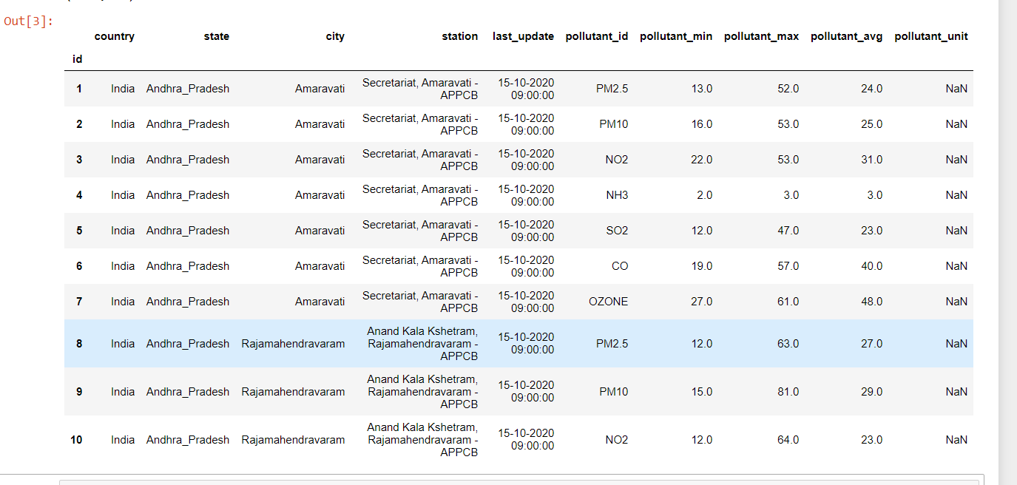
RAW DATA
Fixed it by increasing number of columns, and decreasing the rows.

Slide 7
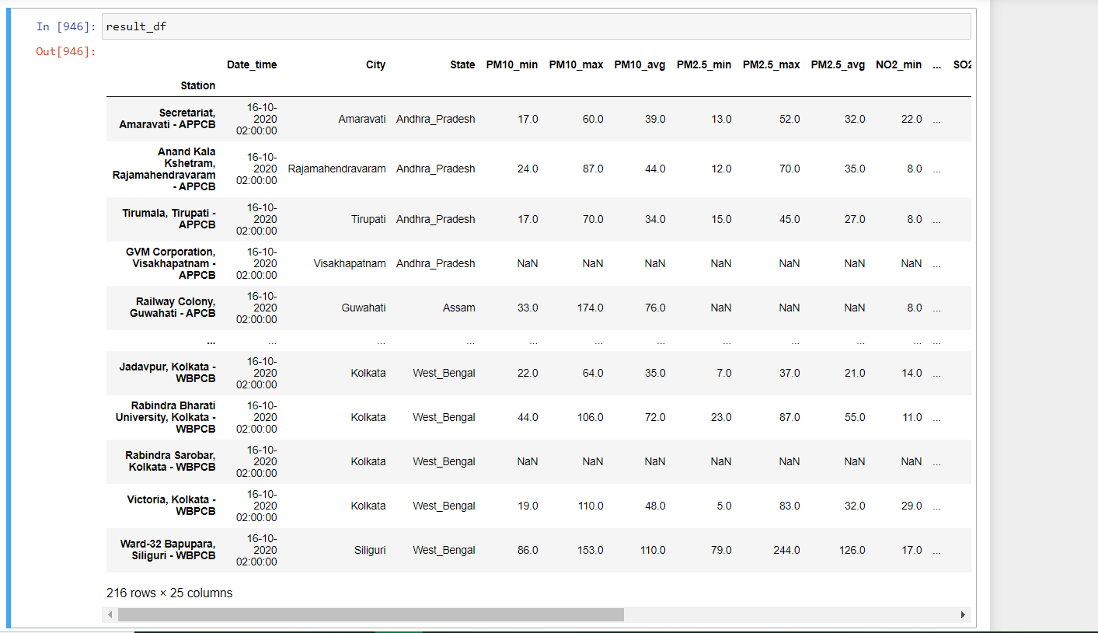
CLEANED DATA
Reduced the size of one csv from (~140KB) to (~36KB).

Slide 8
Dataset description
The final cleaned dataset has the following columns:
City
Station
Timestamp when the data is recorded.
Minimum, average and maximum values of the pollutants recorded for the time in timestamp.
Pollutants : SO₂, CO, Ozone, NO₂, NH₃, PM2.5, PM10

Slide 9
Some inferences from the dataset
The stations for measuring AQI are only present in some locations of the country.
As a result, there are areas which don’t have an AQI station while some cities end up having many in relatively close locations.
In various cities like Vizag, even after the presence of AQI stations, most of the readings are NULL.
Also for some cities, such as Ahmedabad, there is only one station in the whole city : this results in incorrect readings. (Ahmedabad is a polluted city, but according to our dataset it isn’t.)

Slide 10
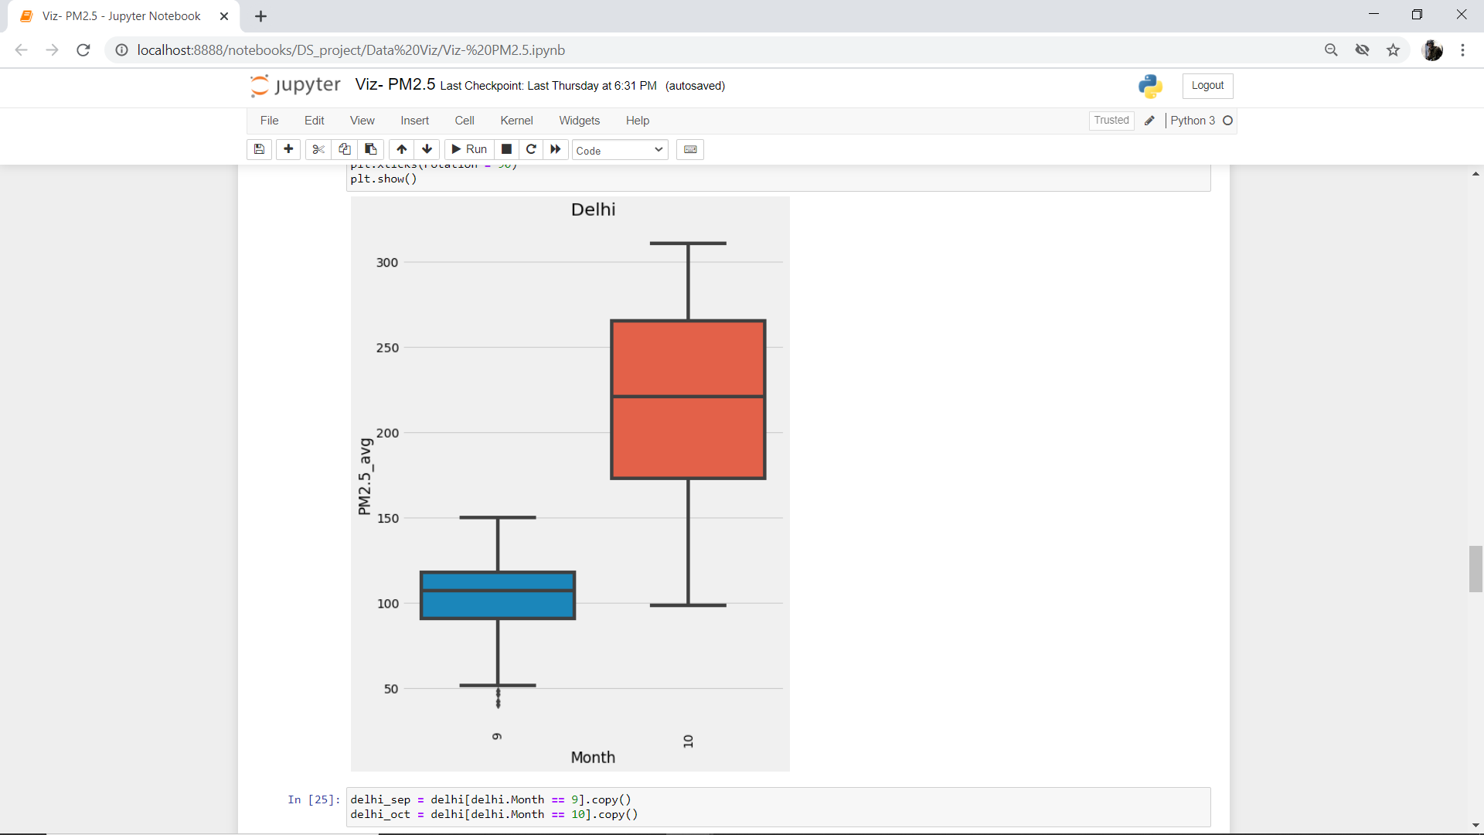
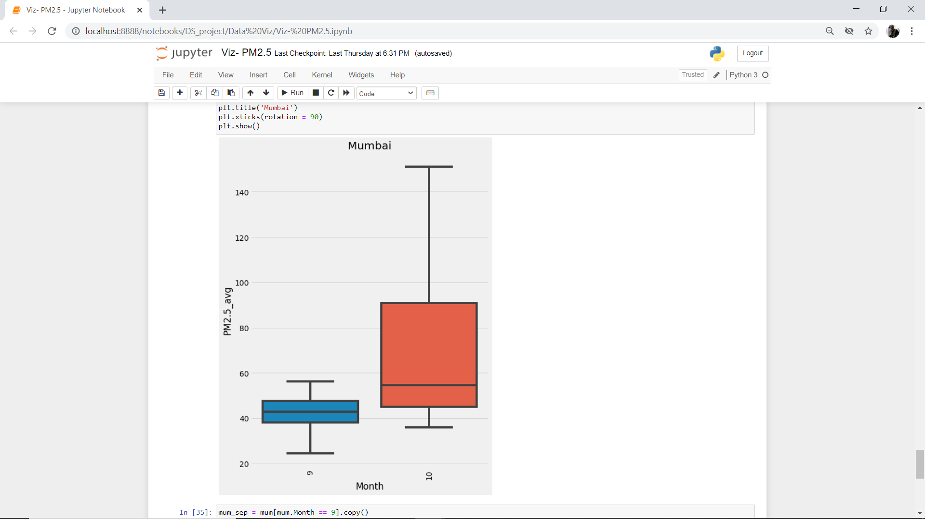
PM2.5 Box Plot for major cities

Slide 11
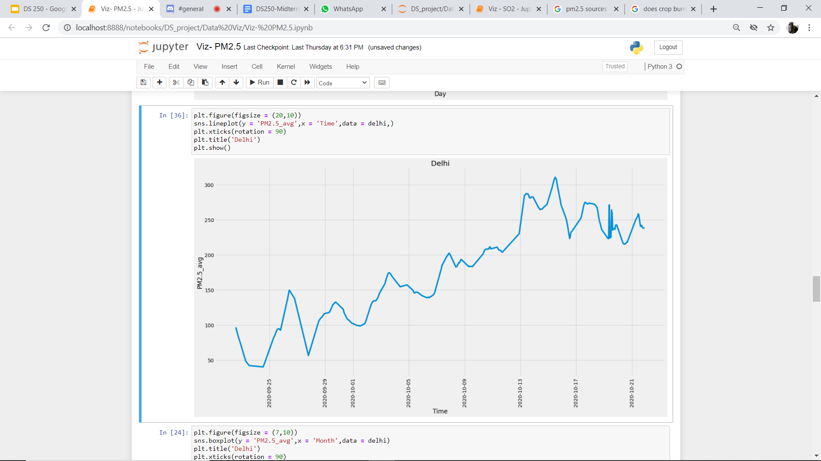
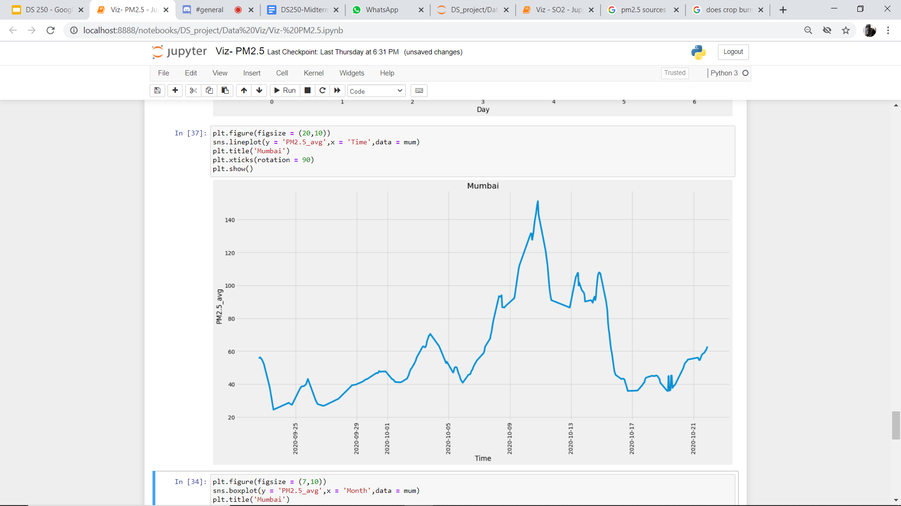
Average PM2.5 levels timeline
Delhi
Mumbai

Slide 12
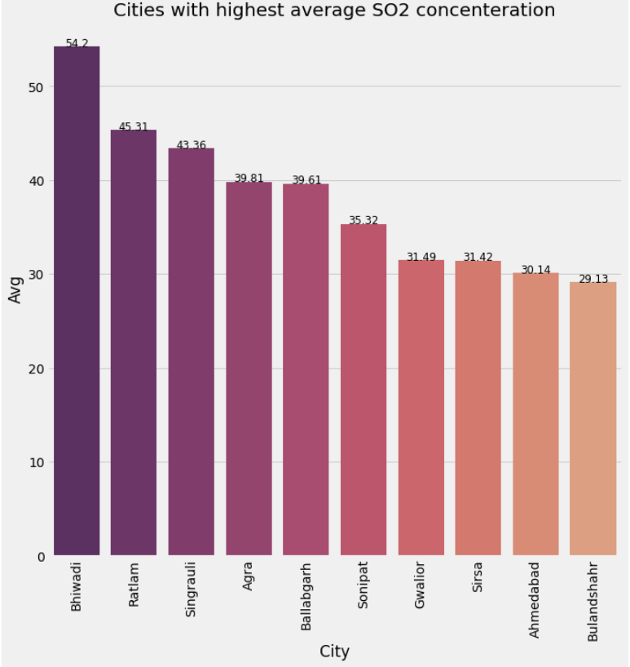
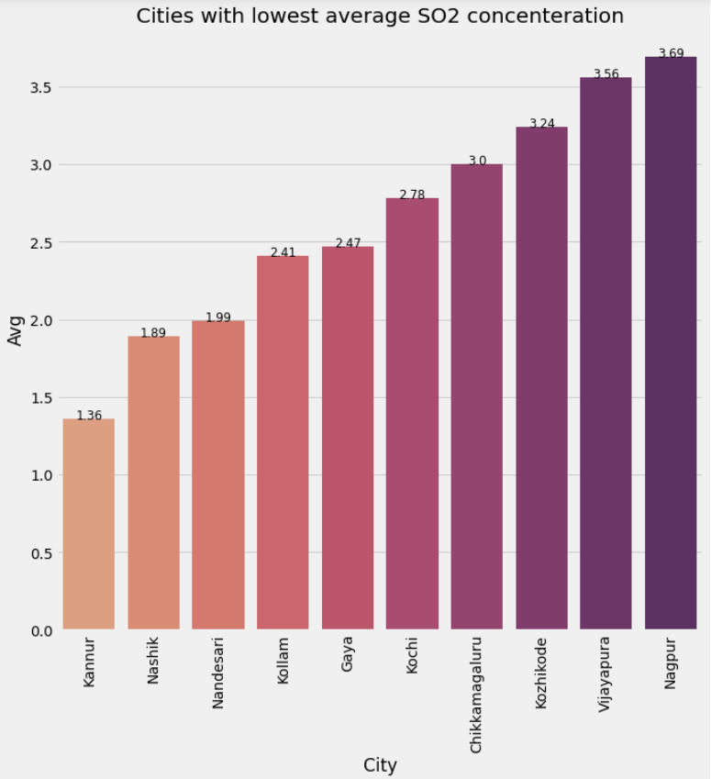
Bar Graph for SO₂ concentration

Slide 13
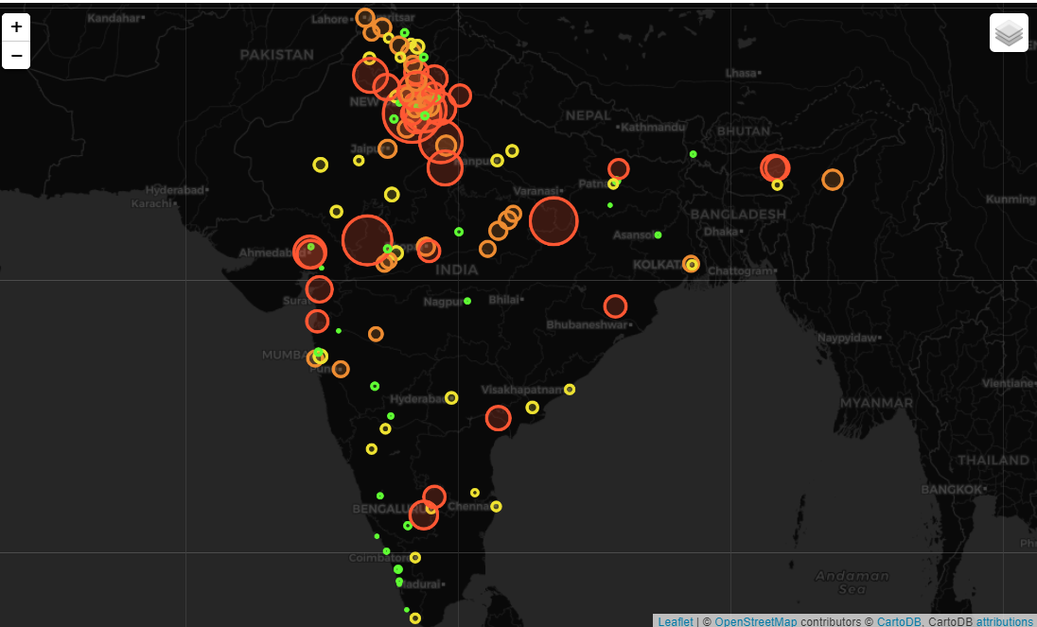
Visual Representation
Map of India showing average SO2 concentrations across India over the period of our data collection.

Slide 14
Models
We used ARIMA model as our data was a univariate Time series. We have to use SARIMA model too as our data had seasonality.
We have used different models for different cities across the country.
Our training data is 90% of the total data and test data is 10% of the total data.
It was difficult to select the parameters for the ARIMA model, as sometimes parameter which we infer from graph gives more percent error than some other parameters.

Slide 15
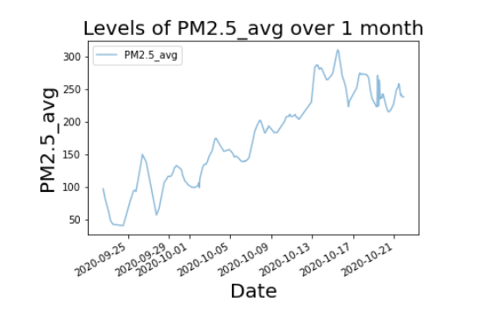
Resampled data

Slide 16
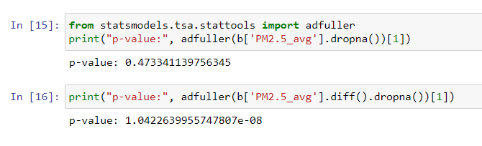
...
First of all our time series was not stationary so to make it stationary we took d=1 and then it passed AD fuller test
After this, from the ACF and PACF plot got p=2 and q=0
So Final model parameter are (p,d,q) = (2,1,0)

Slide 17
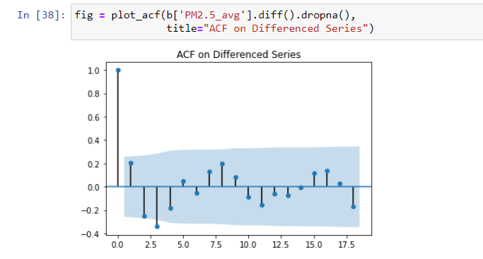
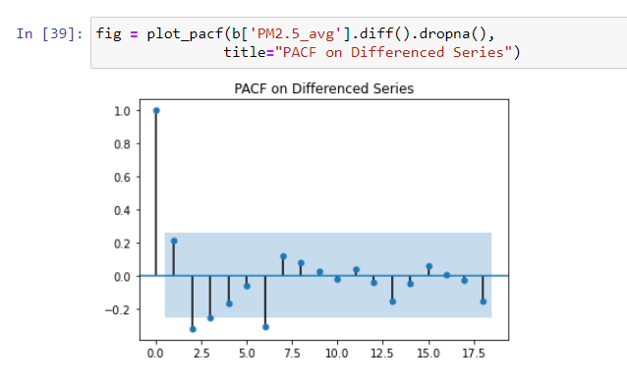
Selecting p and q

Slide 18
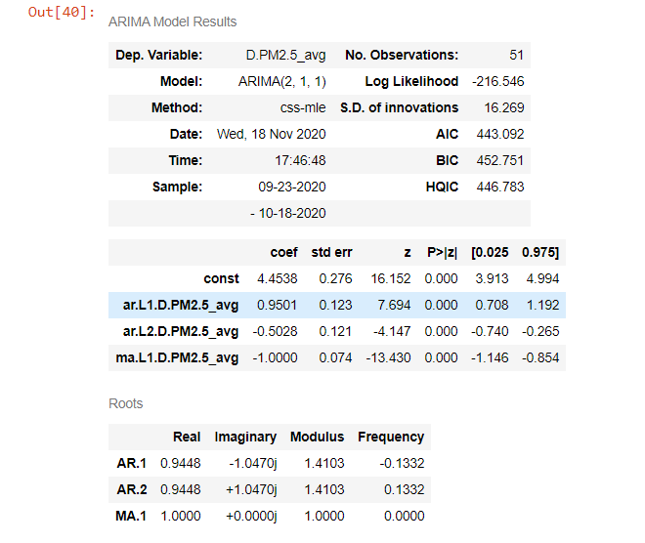
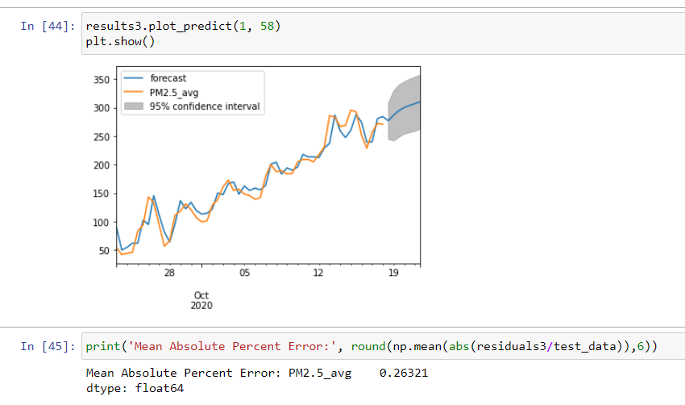
This is the summary for our ARIMA(2,1,1) model with the data from delhi and on PM2.5_avg value
And for this model we got MAPE = 26 % and to get better accuracy we tried SARIMA model

Slide 19
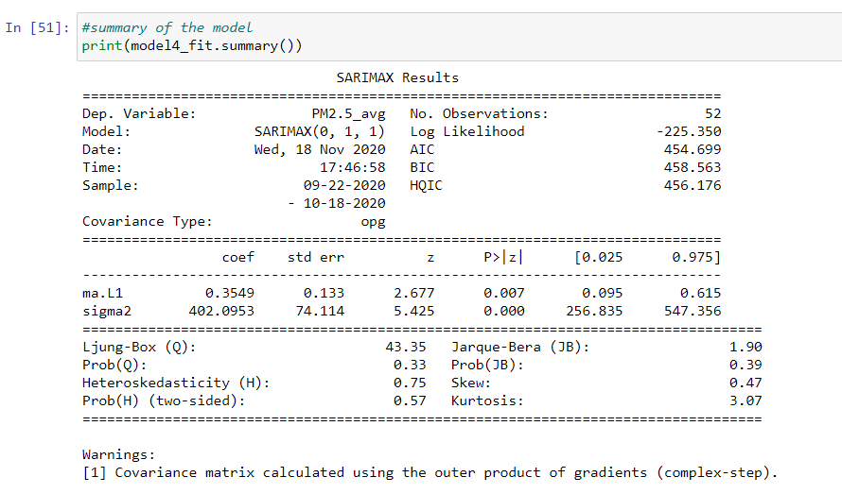
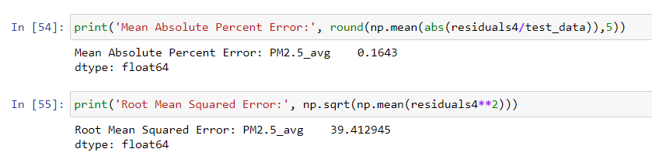
After this we tried to fit our model using SARIMA model using auto ARIMA it yielded the following model
We got the final model as SARIMA(0,1,1)x(0,0,0,7)

Slide 20
Further plans
AQI predictions for some major cities.
We will study the data to identify cities/areas in which AQI is deteriorating most rapidly, but can be controlled after taking proper measures.
Try to find out the reasons for the poor AQI of some cities.

Slide 21
Challenges Faced + Things Learnt
At times of power cut for the system on which we were using crontab, we had to collect data manually for every hour from morning to evening so that we have continuous data.
The selection for model parameters were not so straightforward as in directly from the ACF and PACF plot.
Selecting standards for calculating AQI.
There was this time constraint which restricted us to do even more work towards our project. Hence , optimising time to do maximum progress was not easy.

